Slide 1
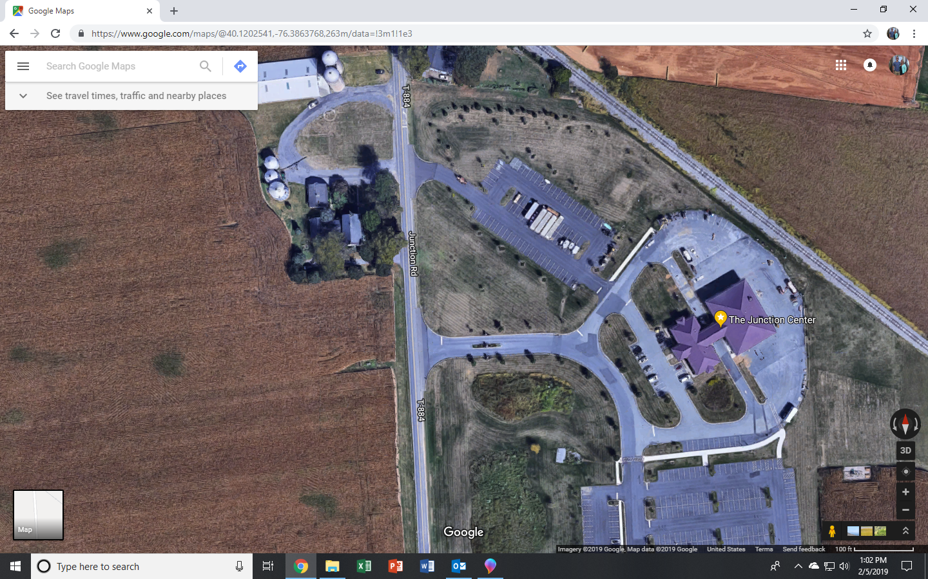
Turn around at ½ mile marker
Start
Course
Finish
Walk Course
Begin in the parking lot near the picnic tables
Walk out the main entrance of the grounds and turn right onto Junction Rd
Walk down Junction Rd until you get to the ½ mile marker
Turn around and walk back Junction Rd and turn left into the main entrance of the property
Veer left and go between WJTL and The Junction Center buildings through the breezeway to the finish line

