Slide 1
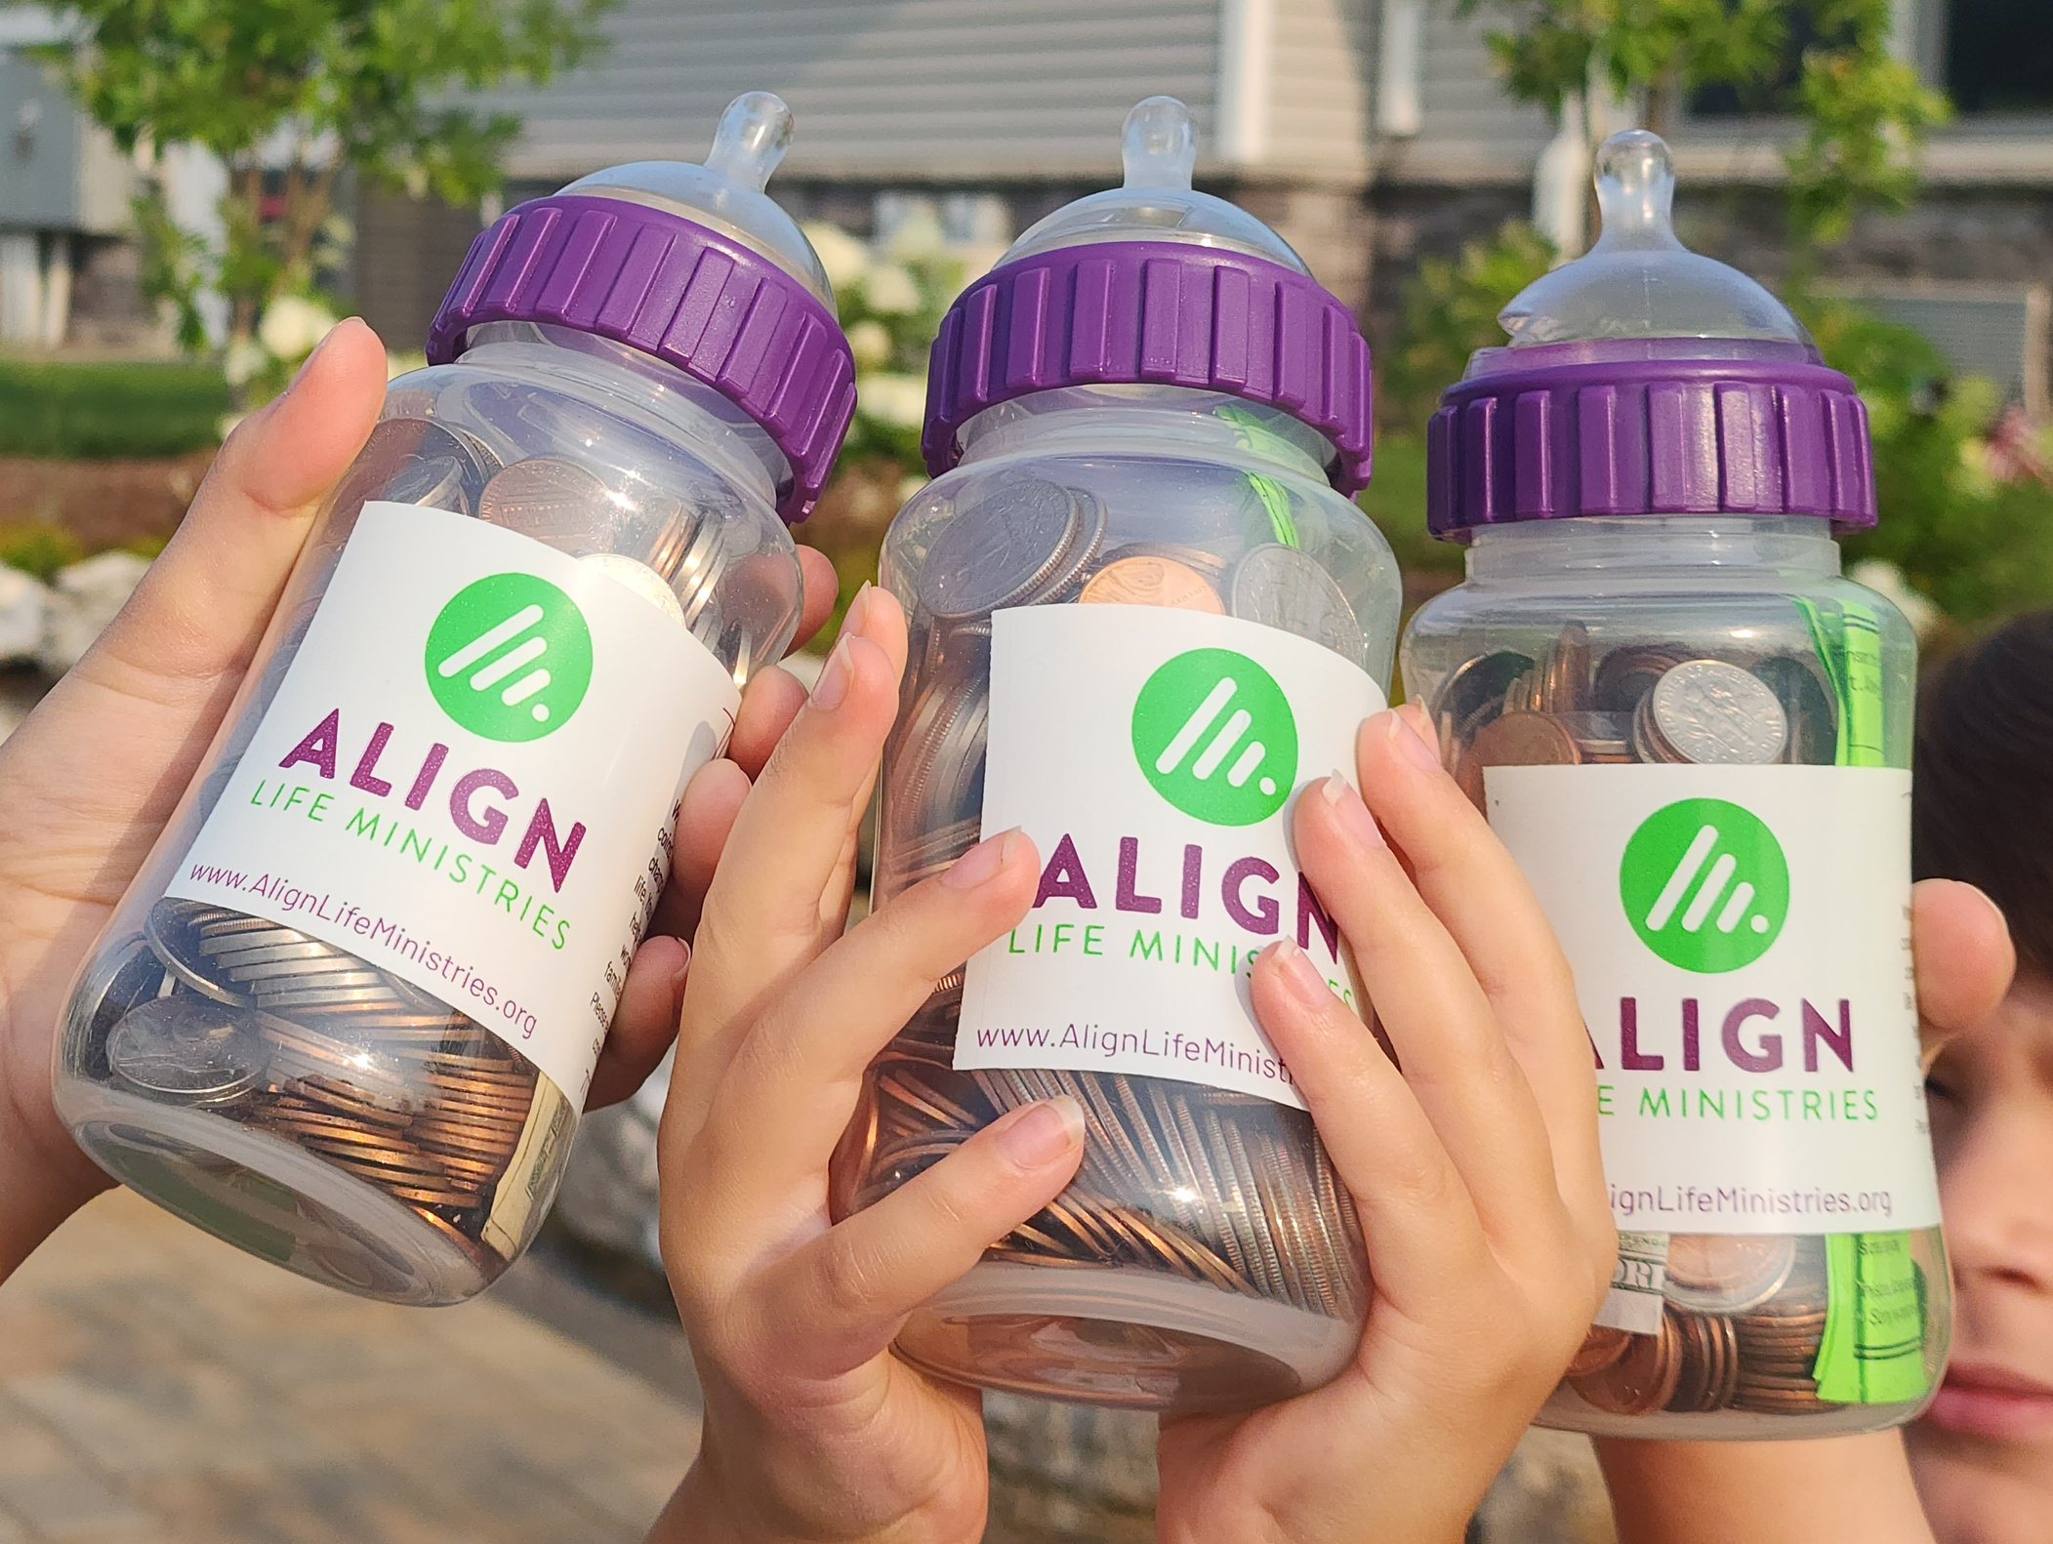
It’s
Baby Bottle
Boomerang
Time!

Slide 2
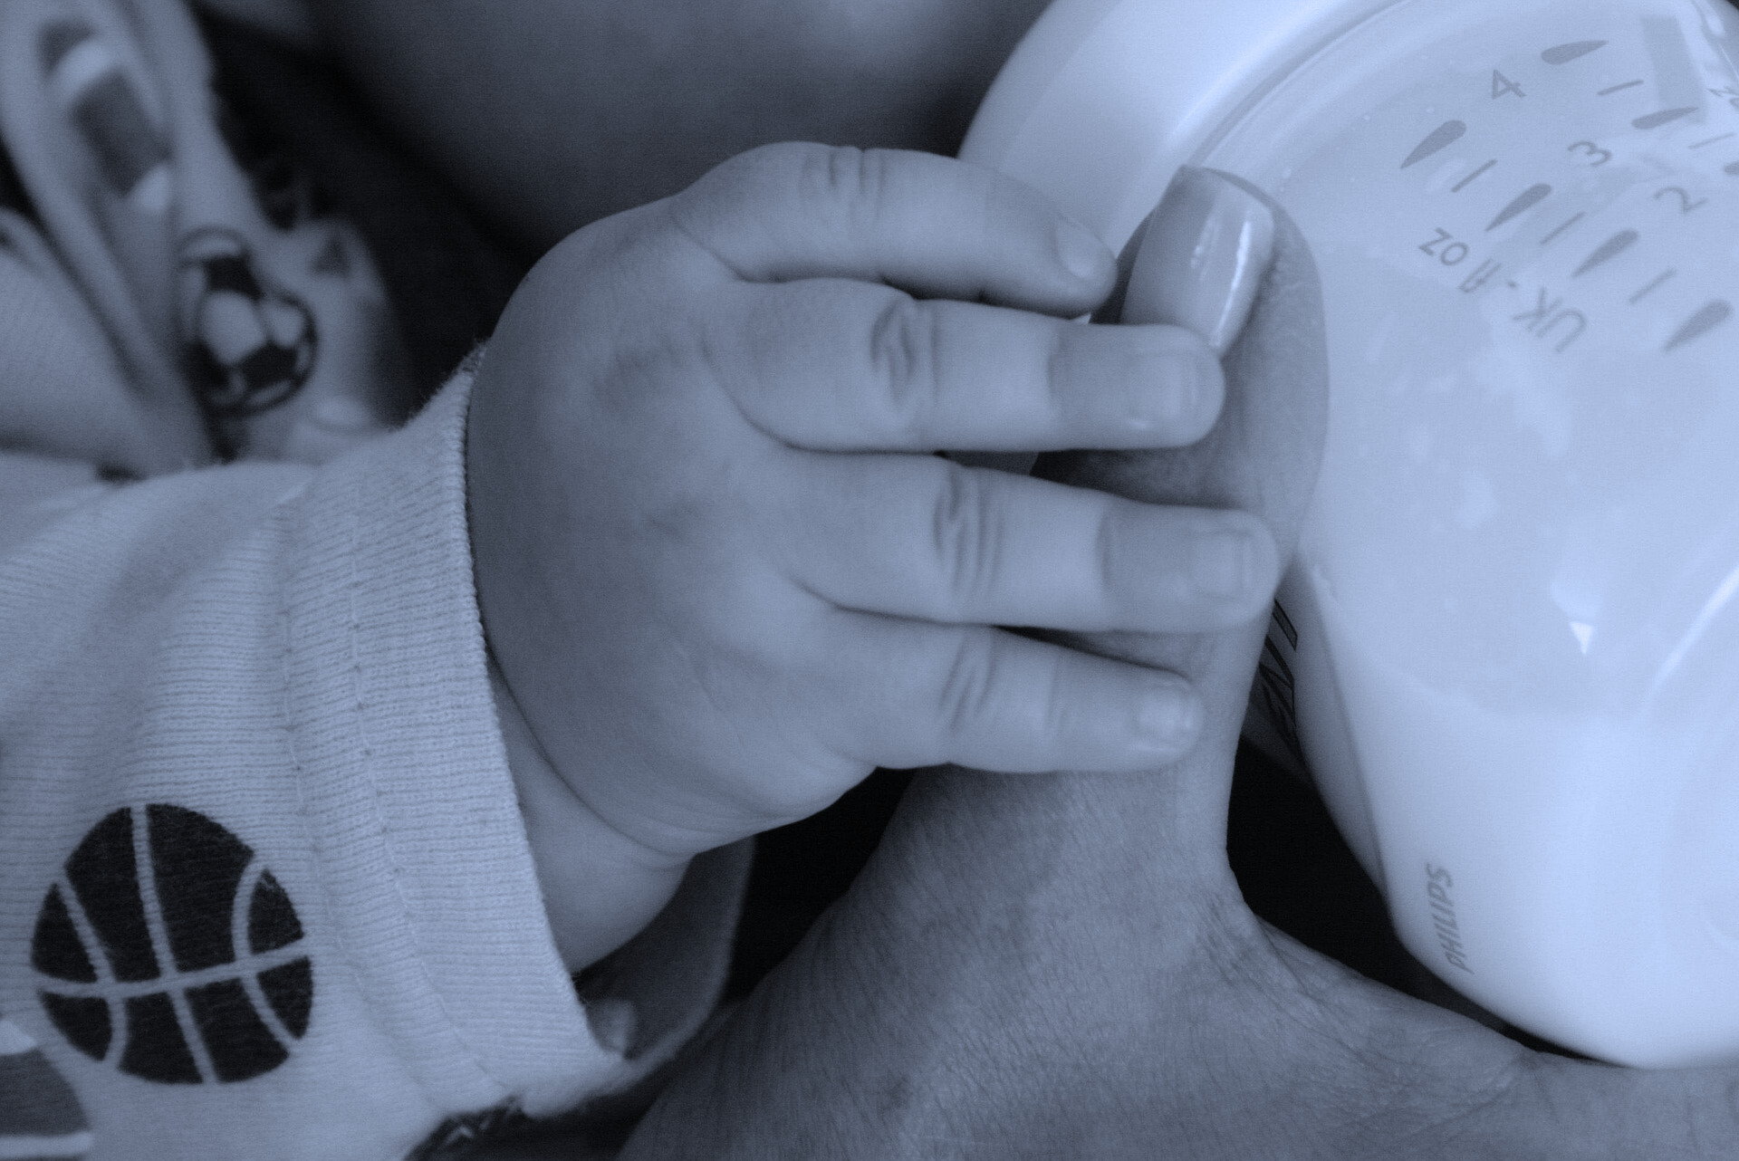

Baby Bottle
Boomerang
Invest in Christ-centered pregnancy and parenting support for local families

Slide 3
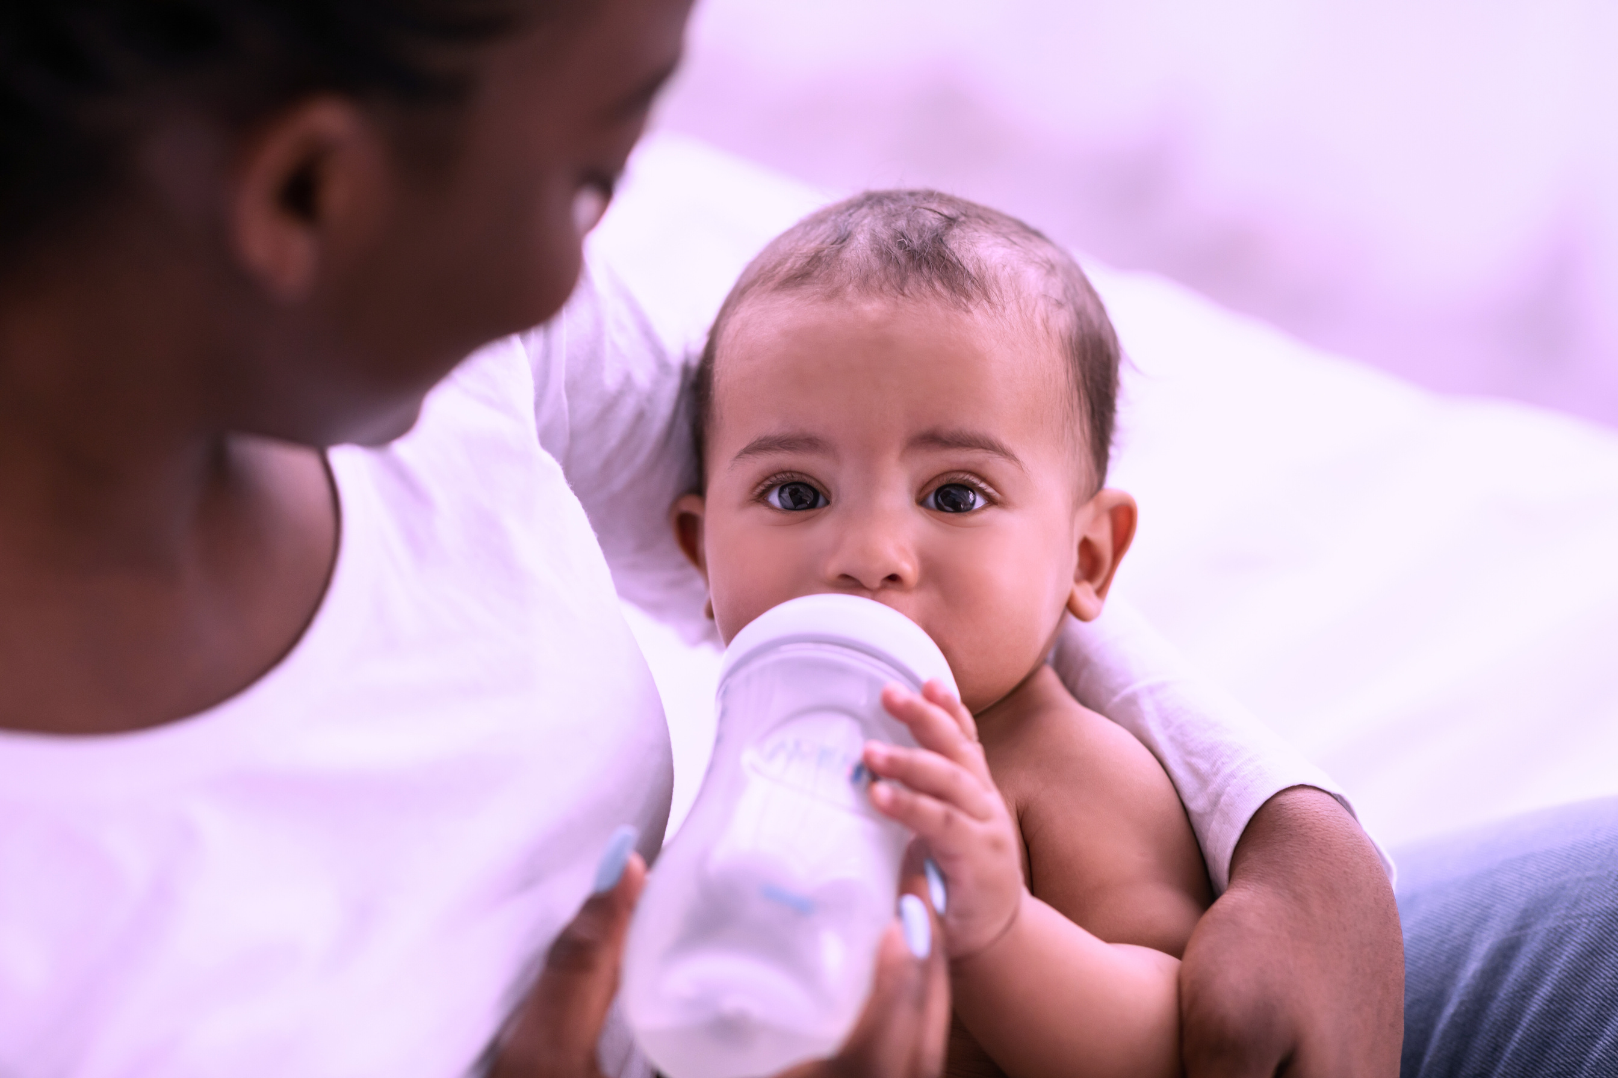

Fill a Bottle
Save Lives

Slide 4


Baby Bottle
Boomerang 2026
Your bottle helps instill confidence in parents of the next generation.

